Slide 1
WHATSAPP CALLS
CREATED BY KHUSHANG PATEL

Slide 2
WHATSAPP CALLS
WhatsApp calls are made via the internet. That means a call will use your data plan, not your network's voice calling ability. In this regard, it works like Skype, Viber, and many other voice-over-IP (VOIP) competitors.
To put it simply, you won't be charged for making a call or have your minutes depleted. However, you will be charged for using data, depending on your phone's data plan.
If you are making a WhatsApp call over a Wi-Fi connection, your phone's network carrier (e.g. AT&T, Vodafone, etc.) won't charge you anything
Yes, video calls are available on WhatsApp. When the VOIP feature first rolled out in 2015, they were not available, but WhatsApp added the functionality in late 2016.
To start a video call rather than a voice call, just tap the video camera icon rather than the phone icon in the top-right corner of the screen

Slide 3
ADVANTAGES
WHATSAPP CALLS CAN BE IDENTIFIED EASILY
THERE CAN BE GROUP CALL IN WHATSAPP
DELETE MISSED CALL ON WHATSAPP CAN BE SHOWN EASILY
WHATSAPP CALL LOG CAN BE CLEARED
SHOWS DIFFERENCE BETWEEN CALL DECLINED AND NOT ANSWERED
WHATSAPP CALLS DOES'NT SHOW UP ON PHONE BILL
WHATSAPP CALLS ARE FREE
REDUCE DATA USED IN CALLS

Slide 4
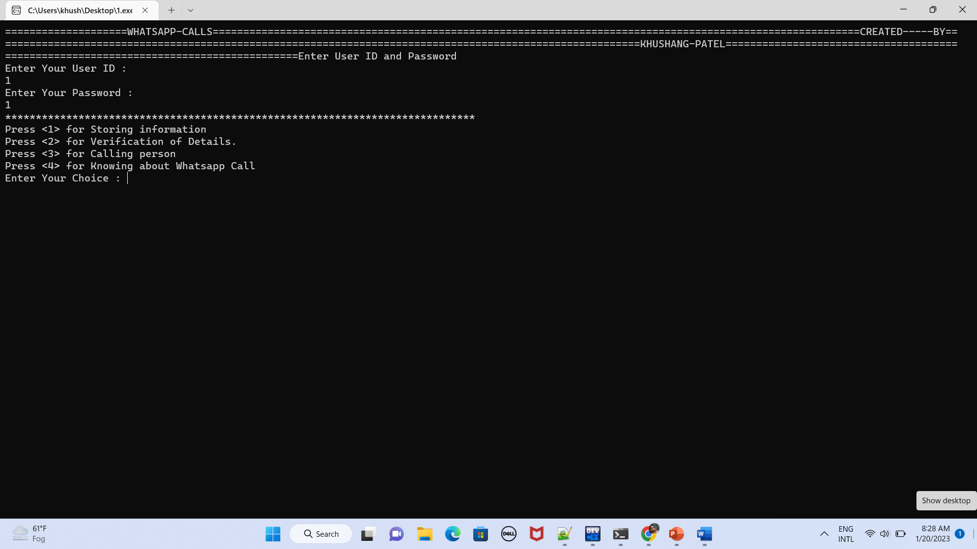
WHEN PRESSED 1 IN PROJECT

Slide 5
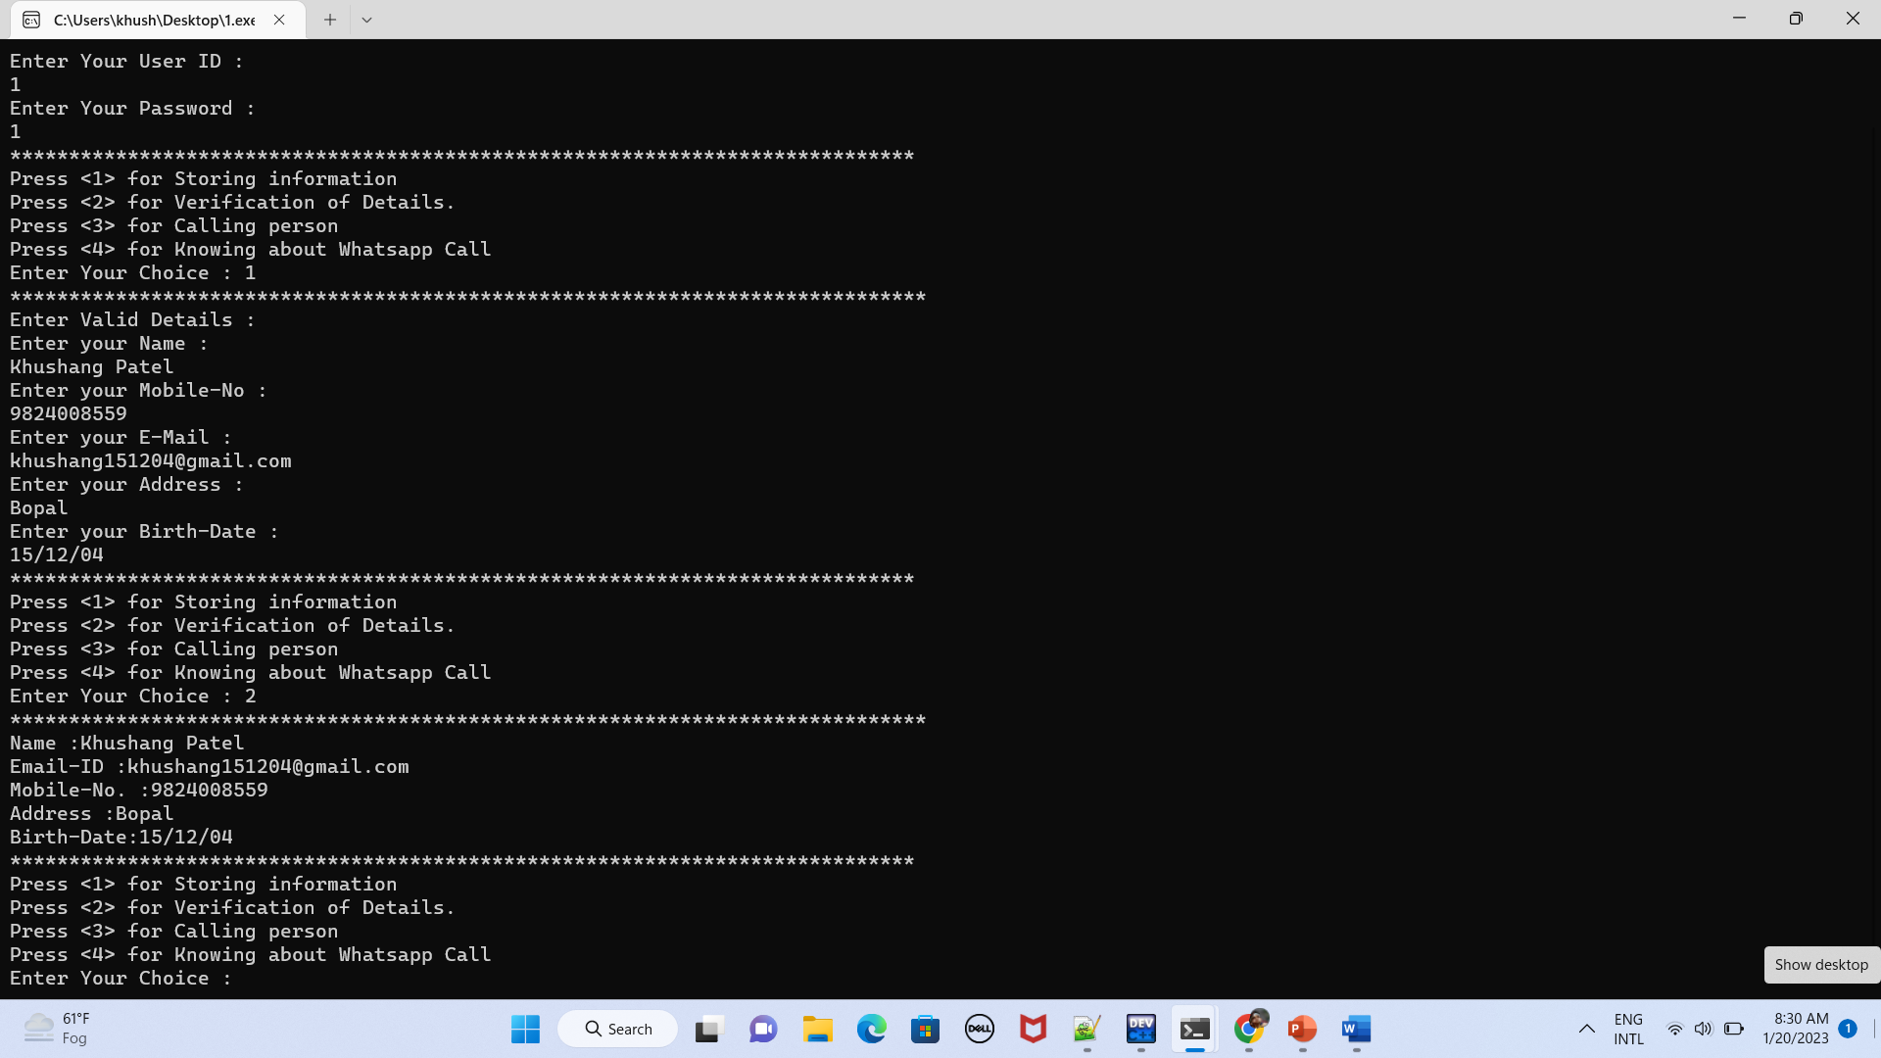
WHEN PRESSED 2 IN PROJECT

Slide 6
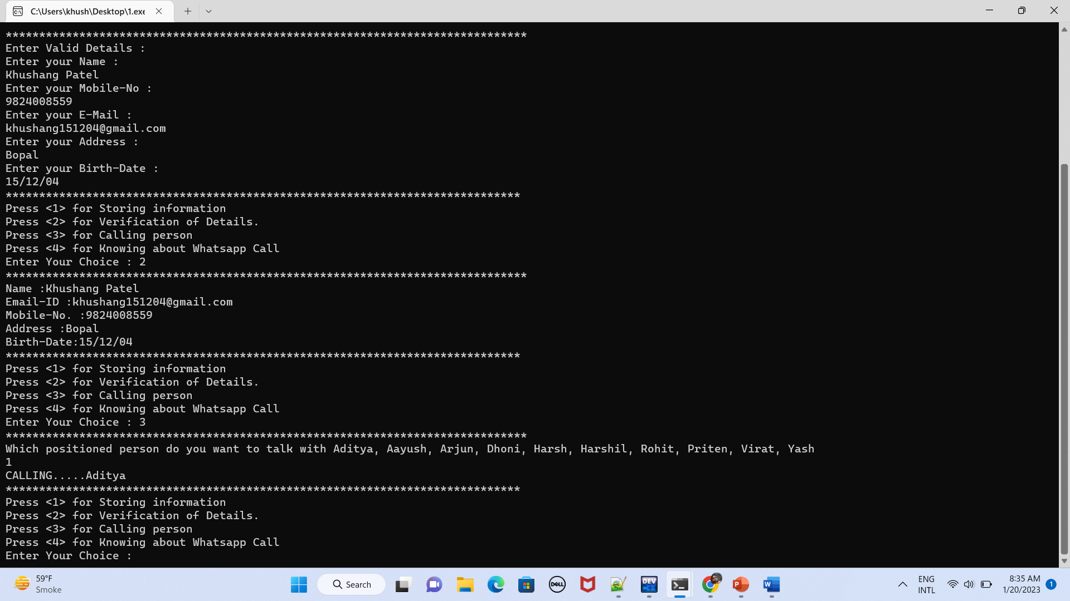
WHEN PRESSED 3 IN PROJECT

Slide 7
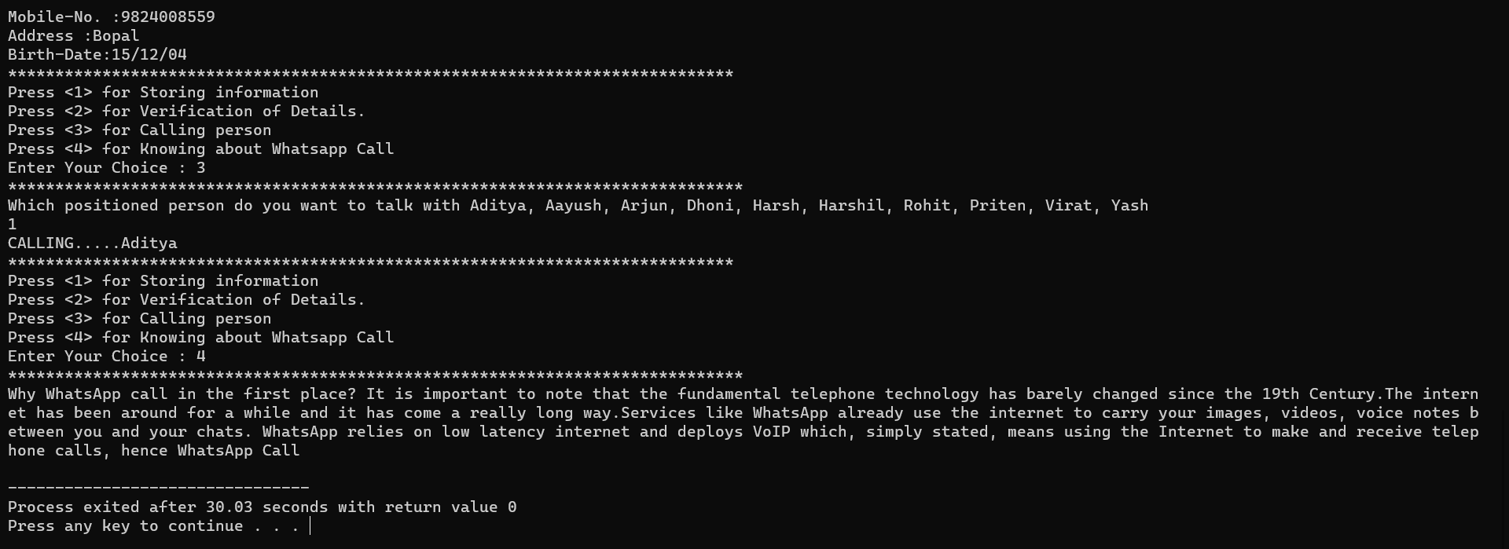
WHEN PRESSED 4 IN PROJECT

Slide 8
SUMMARY
WhatsApp is popular
With the prevalence of smartphones, chances are that a good number of your contacts already are on WhatsApp. This essentially means that you can WhatsApp call as many contacts as you have on your phone…hoping that they are online on WhatsApp when you need them and that they are on WiFi or on a good network.
End-to-End Encryption
It is the most important advantage of WhatsApp. WhatsApp added end-to-end encryption feature to their messaging platform and later extended it to cover WhatsApp calls and videos. WhatsApp’s end-to-end encryption makes your data and communication highly secure. Due to this, no one can eavesdrop on your calls, not your country’s communication authority or big brother.

Slide 9
THANKS FOR VISITING MY PROJECT

